Slide 1
British Airways
Data Collection to gain company insights

Slide 2
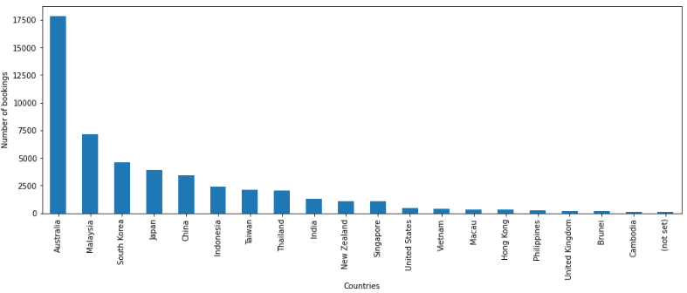
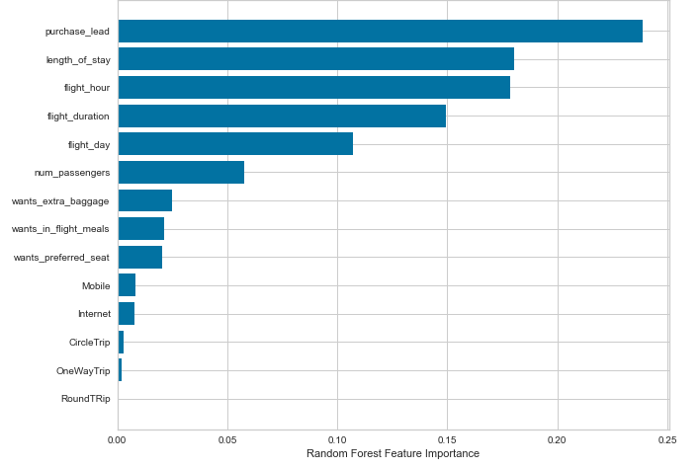
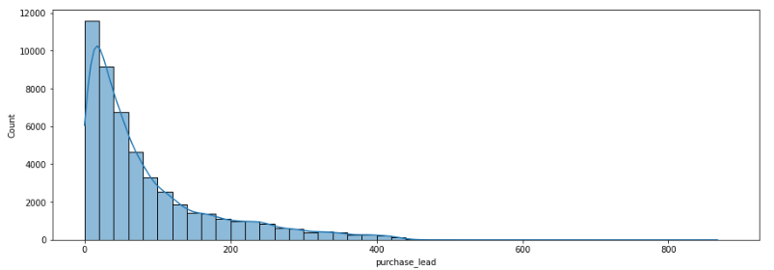
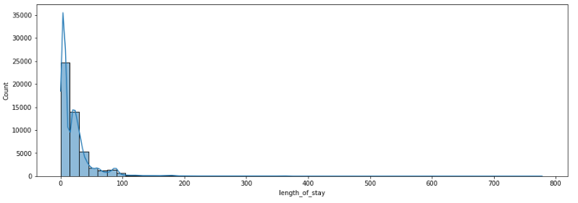
Analysis Results
Accuracy
62%
We are concerned with not predicting the successful bookings correctly. Imbalance dataset drives higher accuracy but it does not accurately predict the successful bookings.
Dataset was balanced with 8k labelled as incomplete bookings and 7k as complete bookings.
Precision
61%

